Slide 1
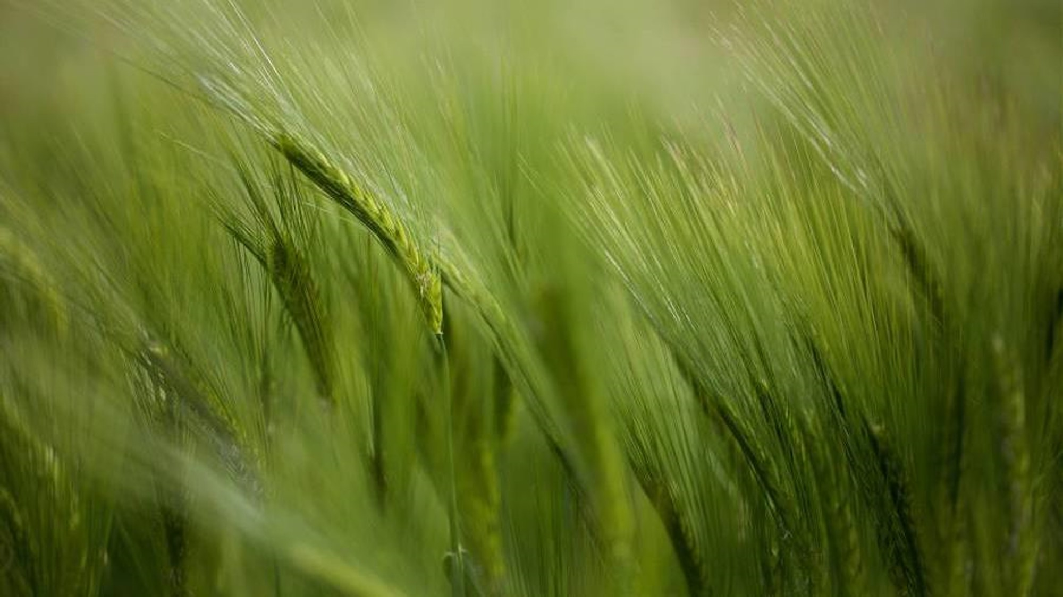
Agricultural Weather Insurance Framework for Kentucky Farmers
Michael Little –
Project Code # 1x7eay8hr09z4dgppr1x7eay8odypt9p

Slide 2

Agricultural Weather Insurance: Solution Overview
Protecting Kentucky Farmers with Blockchain-Based Parametric Insurance
Problem Statement
Kentucky farmers face increasing weather volatility due to climate change
Traditional crop insurance involves lengthy claims processes and delayed payments
Many weather-related losses go uncompensated due to bureaucratic friction
Small farmers are especially vulnerable to financial instability after weather events
Our Solution
A blockchain-based parametric weather insurance platform that:
Automatically triggers payouts based on verified weather data
Eliminates the need for claims adjustment or proof of loss
Provides rapid financial relief when farmers need it most
Makes insurance accessible through a simple, transparent platform

Slide 3
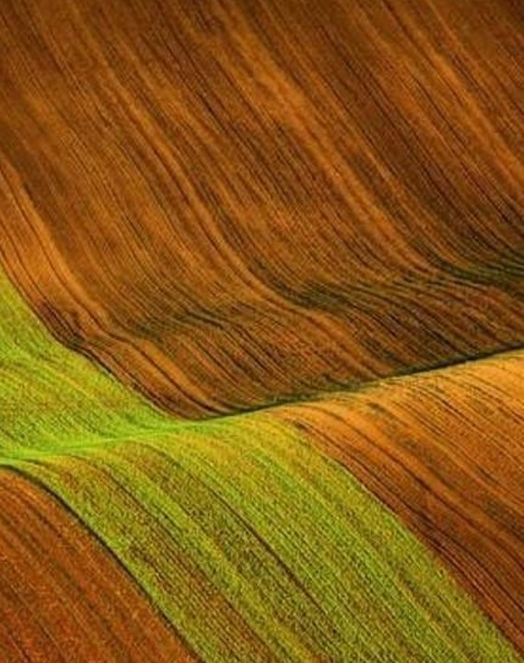
Workflow & innovations
How It Works
Farmer purchases a customized policy through our platform
Smart contract holds the policy terms and premium funds
Weather data from NOAA is verified through Flare Network's data connector
When weather events exceed predefined thresholds, payouts trigger automatically
Funds transfer directly to the farmer's account without delay
Key Innovations
Flare Data Connector: Using decentralized oracles for trusted weather data validation
County-Specific Risk Models: Custom thresholds based on historical weather patterns
Customizable Coverage: Farmers select specific risks relevant to their crops
Transparent Execution: All terms and conditions encoded in smart contracts
Tiered Payouts: Compensation scales with event severity

Slide 4
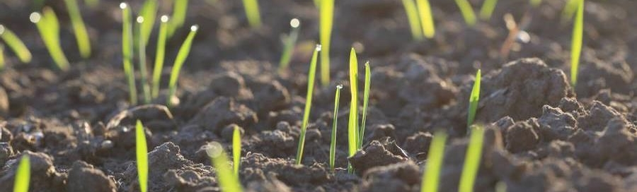
Technical architecture
Three-Component System:
Data Extraction Service: Processes NOAA weather data
Smart Contracts: Execute insurance logic on the blockchain
User Interface: Provides farmer-friendly access and monitoring
Main Components
Data Components
Weather Data from NOAA
Flare Network Components
Data Extraction Service
Flare Data Connector
Formatted Data
Smart Contracts (Sepolia)
Verified Data
Data Availability Layer
User Interface (React)
Proofs
EVMTransaction Verification
Contract State / Events

Slide 5
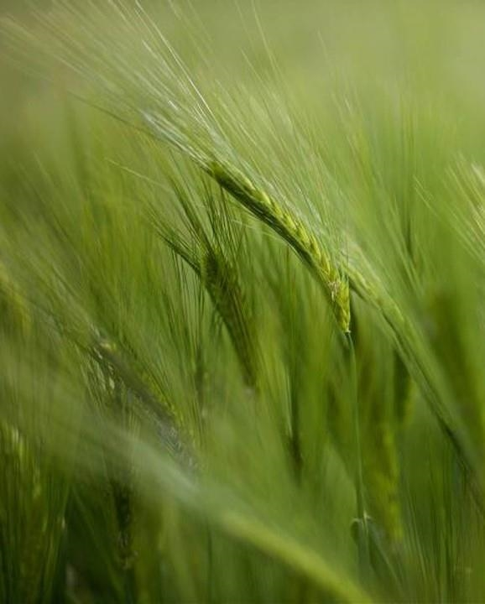
Flare Network Integration
Flare Network Integration
Our solution leverages Flare's unique capabilities:
Data Connector (FDC): Securely validates external weather data on-chain
EVMTransaction Verification: Ensures the authenticity of weather readings
Data Availability Layer: Provides transparent proof storage
Flare Integration Details
Key files demonstrating Flare integration:
AgriculturalWeatherInsurance.sol: Contains the core submitWeatherData function using Flare's verification
prepare-fdc-attestation.js: Prepares attestation requests for Flare's Data Connector
get-fdc-proof-v2.js: Retrieves proof from Flare's Data Availability Layer
end-to-end-fdc-test.js: Demonstrates the complete data validation flow

Slide 6
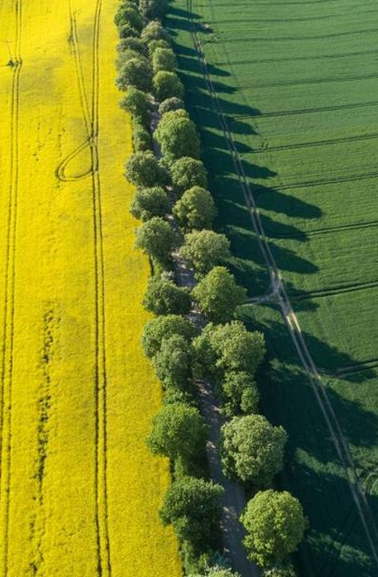
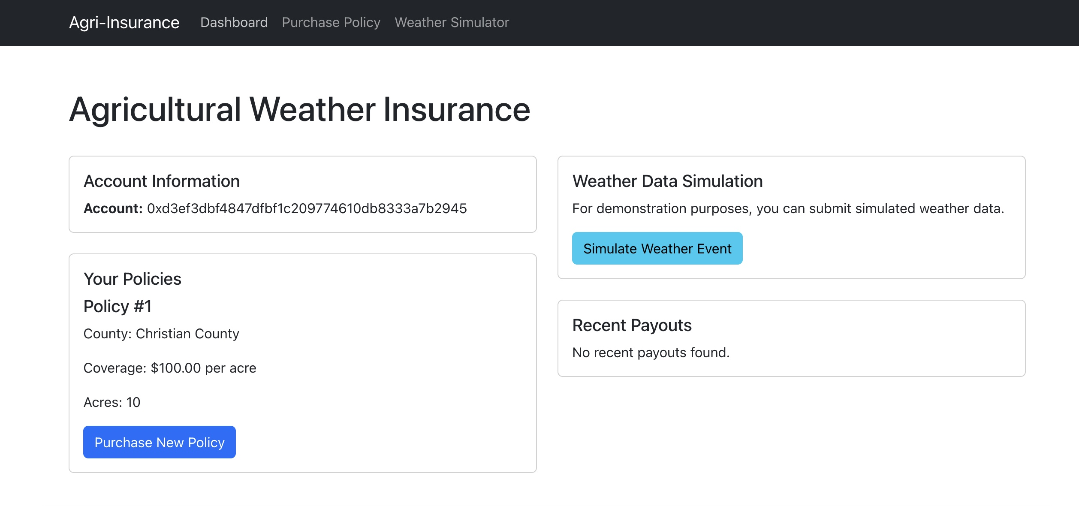
User experience
Example Coverage
Corn Farmer in Christian County:
6-month policy (April-September)
Drought + Heat stress coverage
$300/acre coverage limit on 100 acres
Premium: $1,500 ($15/acre)
Potential Payouts:
Moderate drought (5+ days): $9,000 (30%)
Severe heat wave (6+ days above 95°F): $18,000 (60%)
Extreme weather event: $30,000 (100%)
Simple policy creation wizard
Real-time weather monitoring dashboard
Automatic notifications as conditions approach thresholds
Transparent tracking of all weather events and payouts
No paperwork, no claims process, no waiting

Slide 7

Market Opportunity
Market Opportunity
Kentucky agricultural production: $5.9 billion annually
75,000+ farms across 13 million acres
Only 23% of farmers currently purchase crop insurance
Market gap: affordable, transparent parametric insurance
Expansion potential to neighboring agricultural states
Impact & Benefits
For Farmers:
Faster financial relief after weather events
Transparent, understandable policies
Lower premiums through smart contract efficiency
For Insurance Industry:
Reduced operational costs and fraud
Better risk management through precise data
New market segment of previously uninsured farmers

Slide 8

NEXT STEPS
Next Steps & Vision
Additional weather data sources for redundancy
Machine learning for predictive risk assessment
Mobile application for on-site monitoring
Integration with traditional insurance platforms
Expansion to additional agricultural regions
Implementation Timeline
Phase 1 (Complete): Prototype with three counties and five weather risks
Phase 2 (3 months): Expand to all Kentucky counties, improve UI/UX
Phase 3 (6 months): Add crop-specific modeling and advanced analytics
Phase 4 (12 months): Deploy to production with regulatory compliance

Slide 9
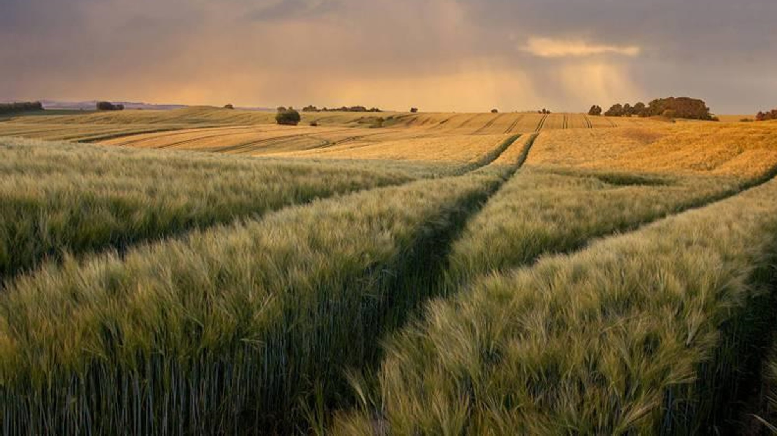
Thank You!
Special Thanks to Jacob Little and ESGImpact.IO for advisory services on Kentucky climate conditions and trends

